Slide 1


Biped Robot Project - Weekly Progress Report
Team Update - Week 3
Presented
Date: March 2026
Notes:
Hello everyone, welcome to our weekly progress report for the Biped Robot project. Today, I'll walk you through what we accomplished this week, the challenges we faced, and our plan for next steps.

Slide 2
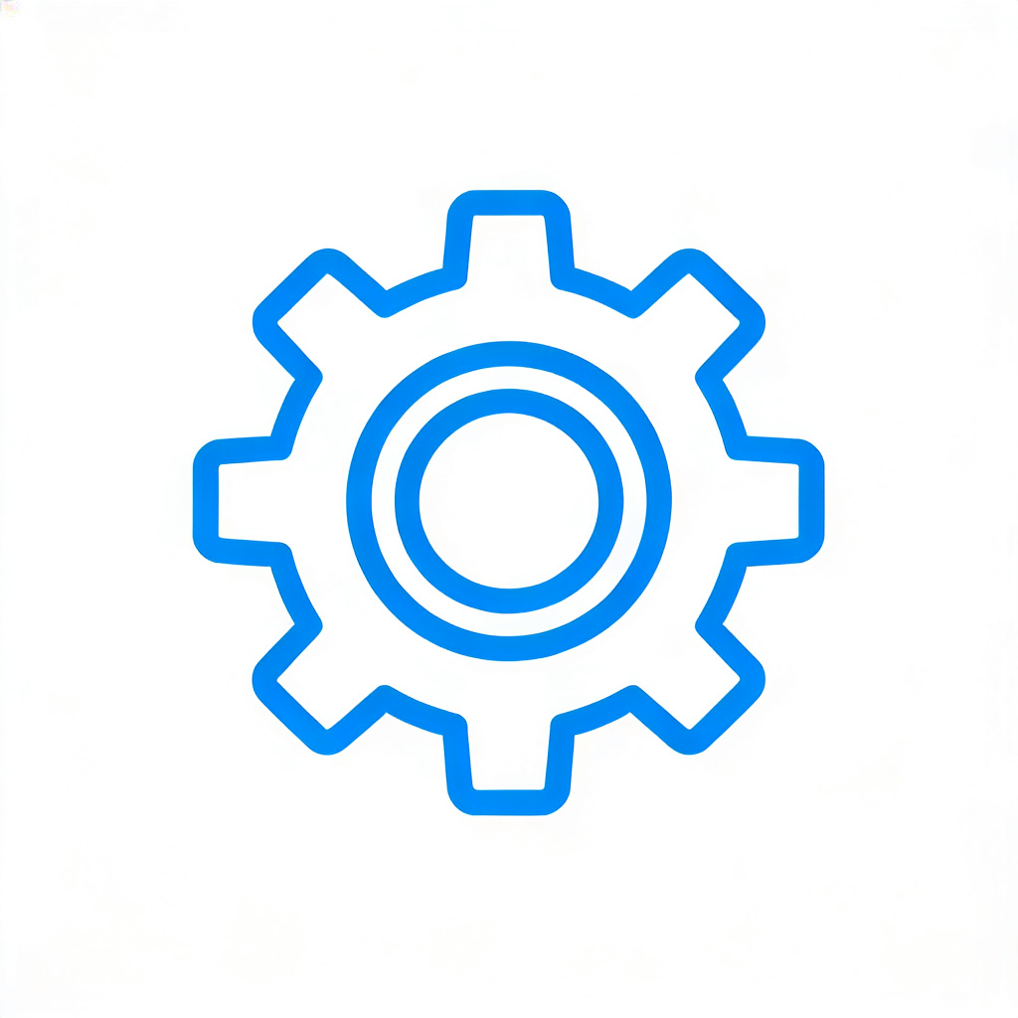



CONTENTS
1.What We Got Done This Week
2.Challenges We Hit
3.Our Plan for Next Week
4.Q&A / Open Discussion
Notes:
Here's a quick overview of what we'll cover today: first, what we managed to accomplish this week, then the challenges we ran into, followed by our plan for next week, and finally, we'll open it up for questions.

Slide 3
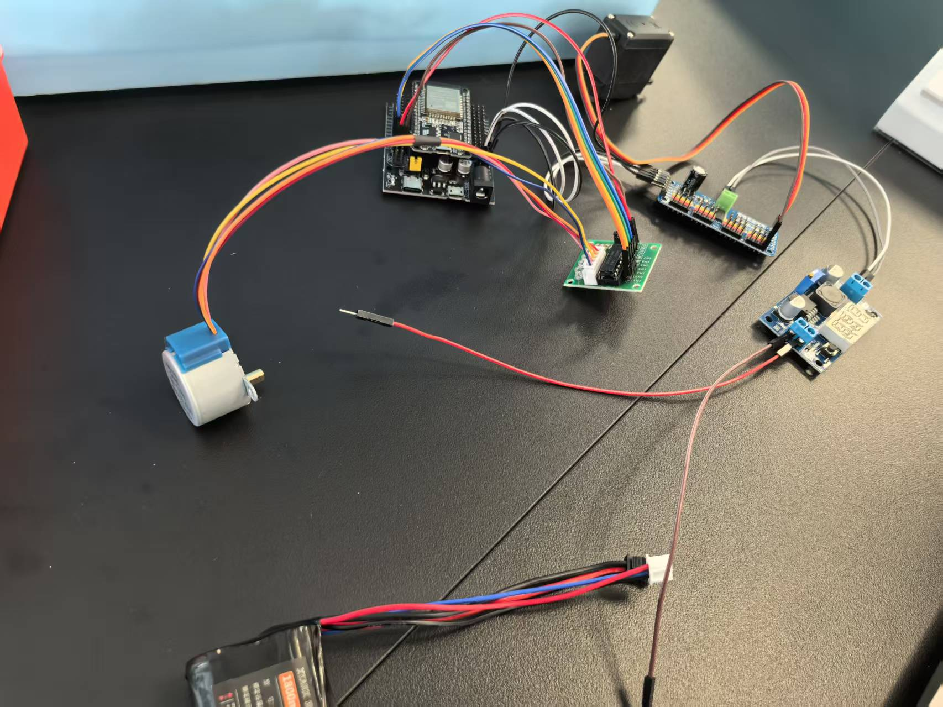


What We Got Done This Week
Got all the motors wired up and working!
We successfully connected all the robot's motors and checked that they power up correctly.
Figured out all the pin connections
We mapped out and secured all the control and power pins, which is crucial for writing the control code later.
Next plan: Based on the confirmed pin definitions, start the development and integration testing of the underlying driver.
Notes:
This week, we focused on the electrical side of things. We got all the motors connected and confirmed they work. We also finalized where all the wires and pins need to go, which sets us up nicely for programming the robot's movements.

Slide 4
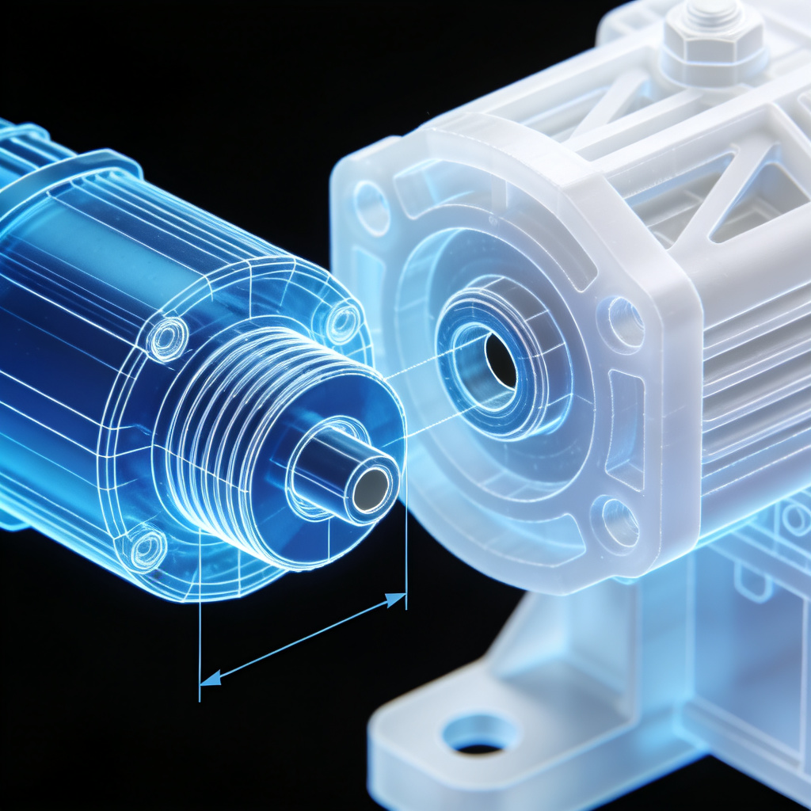


Challenges We Hit
3D printed parts didn't fit the motors
When we tried to fit the motors into the 3D printed parts, we realized the holes were too small—we didn't account for the motor's size tolerance in the design.
Had to pause assembly
This meant we had to stop putting the robot together. We need to redesign and reprint those parts.
。
Notes:
On the mechanical side, we hit a snag. The 3D printed parts we made didn't fit the motors properly because we didn't leave enough space in the design. So, we had to stop assembling the robot and go back to the drawing board for those parts.

Slide 5

Our Plan for Next Week
Redesign the 3D printed parts to fit the motors:Modify the design to add more tolerance for the motors, ensuring they fit smoothly.
Print the new parts:Print the mechanical parts according to the revised design.
Put the robot back together with the new parts:Once the new parts are printed, immediately install the motors and reassemble the structure.
Start testing the motors and try out some basic movements:After assembly, test the motor drivers and attempt simple gait debugging.
Notes:
So, here's our plan to fix this: first, we'll redesign the 3D parts to make sure the motors fit. Then we'll print the new parts, put the robot together again, and start testing the motors to get it moving.

Slide 6
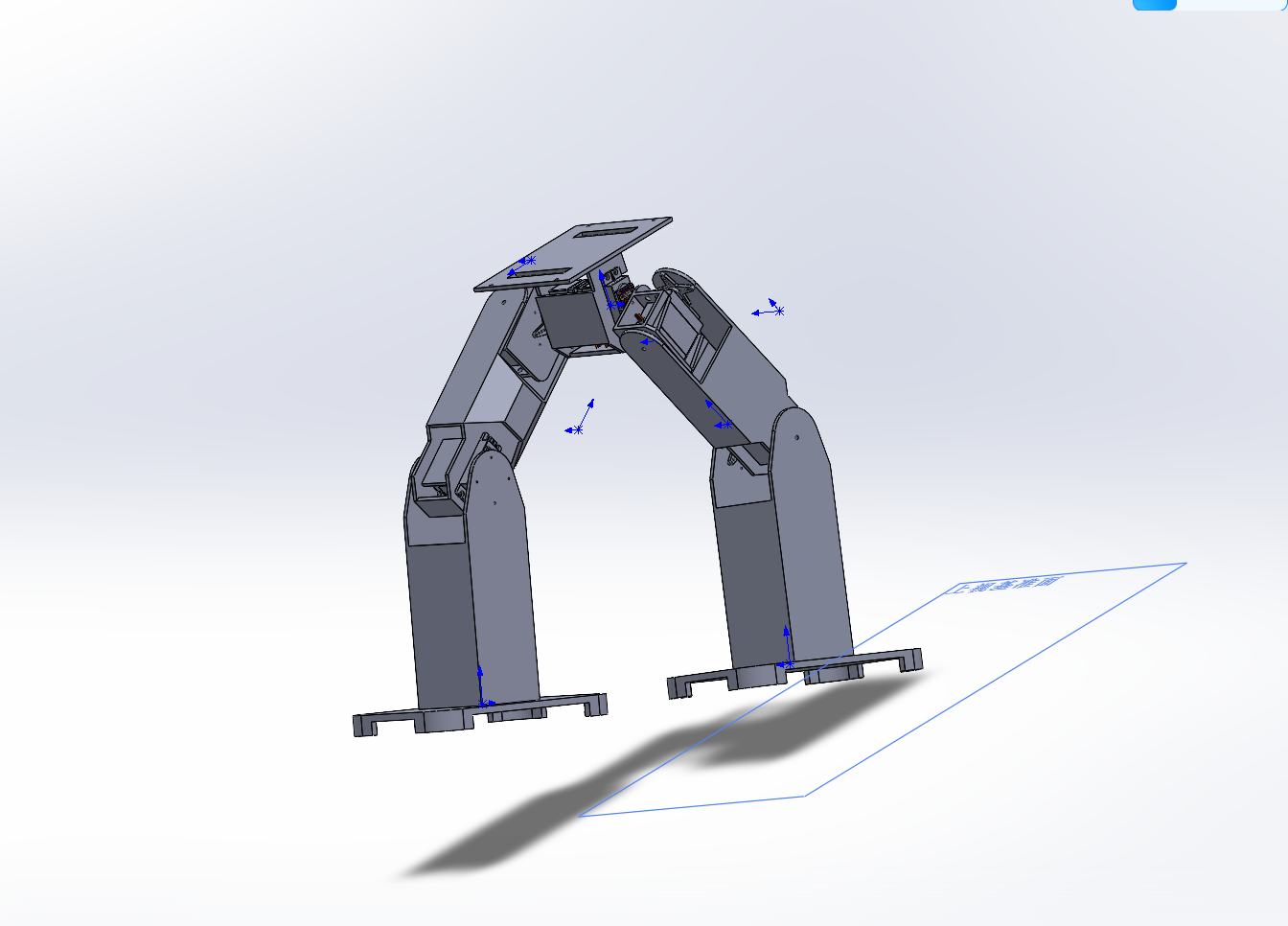



Project Update Summary
Electrical system is good to go!
The electrical part is all set—motors are wired, pins are mapped.
Mechanical assembly is on hold
We're stuck on the mechanical assembly because of the 3D print issue, but we know how to fix it.
Overall, we're on track
We hit a small roadblock, but the project is still on schedule. We're confident we can fix this and keep moving forward next week.
Notes:
To sum up: the electrical system is done and working well. The only hold-up is the mechanical part, which we know how to fix. Overall, we're still on track, and we're looking forward to getting the robot assembled and moving next week.

Slide 7


Thank You
Thanks for listening!
Notes:
Thanks again for your time and attention!

Slide 8

Q & A
Q&A / Open Discussion
Notes:
That's my update for this week. I'll now open it up for any questions you might have.

